Slide 1
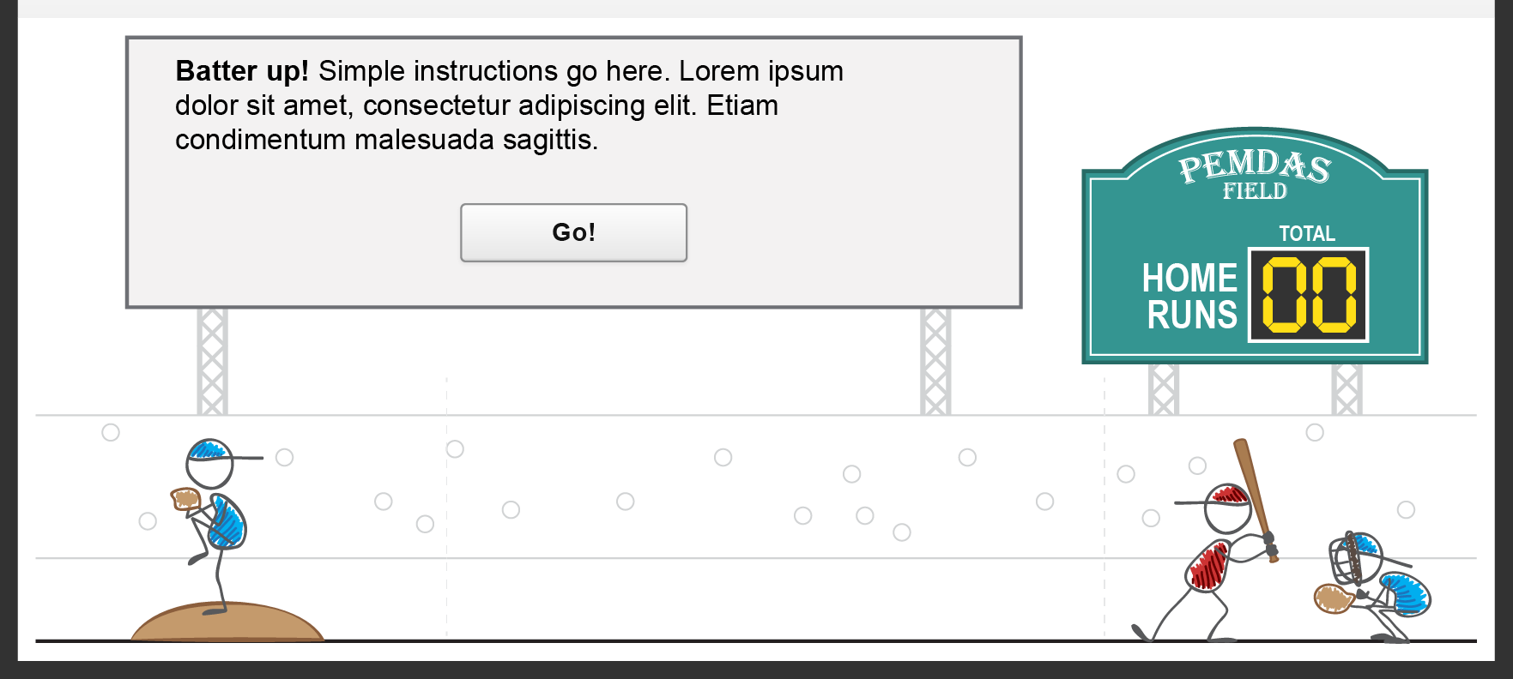
Home run derby
Instruction screen
Instructions should be short and simple. If the student doesn’t read this and proceeds, they should be able to get the hang of the activity anyway.
Student clicks GO when ready.

Slide 2
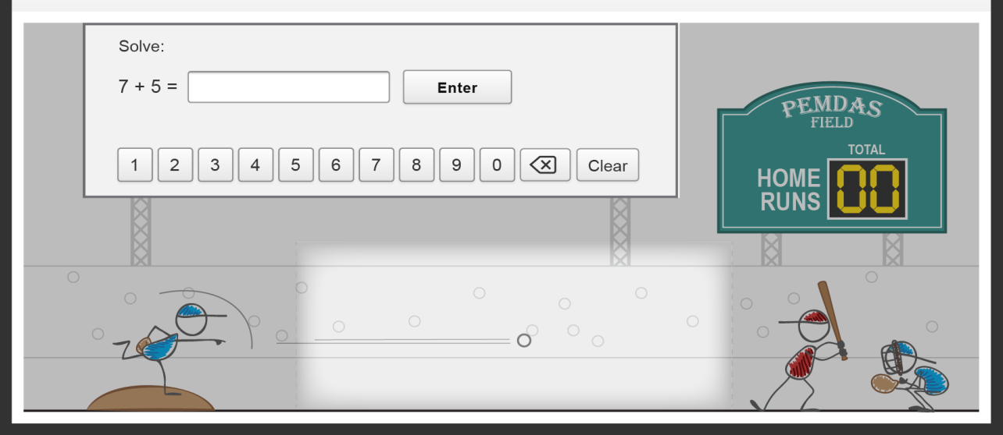
Home run derby
Pitch time
Once the pitcher throws the ball, it enter a slow-mo zone. It takes perhaps 10 -15 seconds to cross the zone at a slow speed. This is the students opportunity to read and solve the problem.
Student can type answer with keyboard (textbox will be automatically focused), or they can click or tap the numbers.
They must click/tap enter to submit answer.

Slide 3
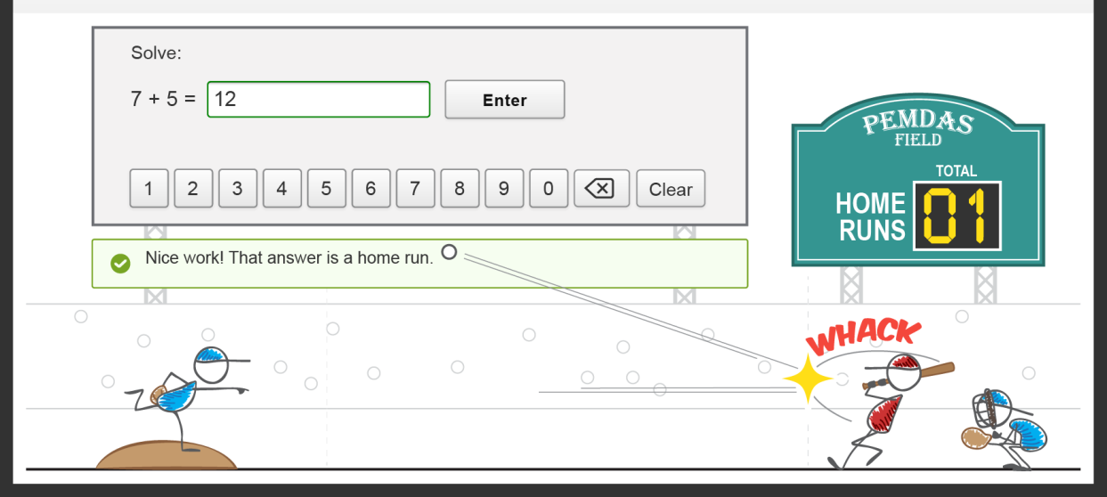
Home run derby
Correct
If the student enters the correct answer in time, they score a home run and are ready for the next problem/pitch.

Slide 4
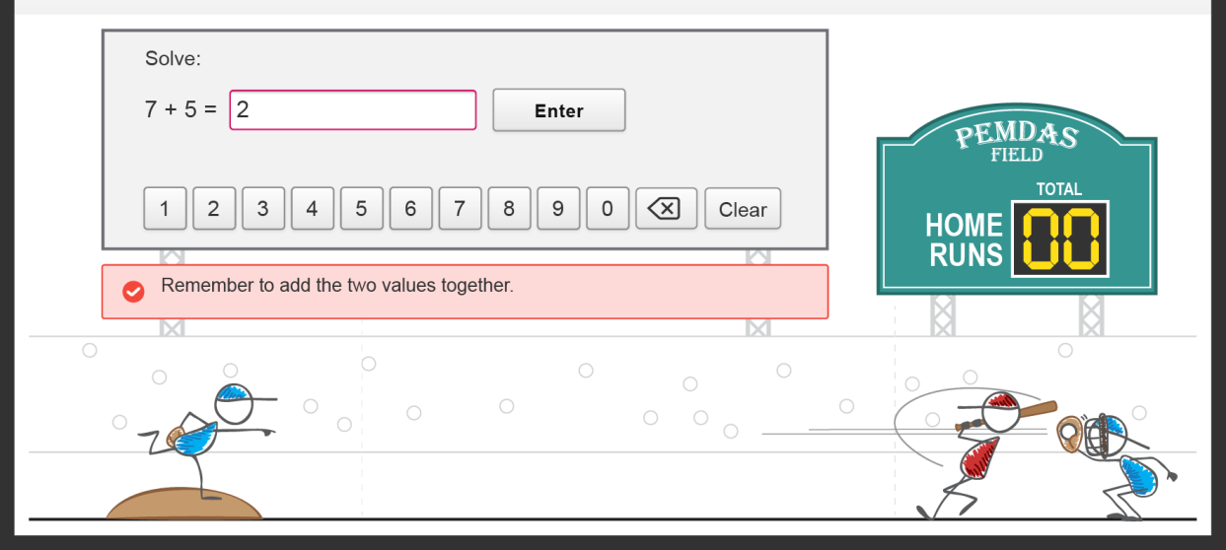
Home run derby
Incorrect
If the student enters the incorrect answer in time, they miss the ball and are provided feedback. Then they can move on to the next problem/pitch.

Slide 5
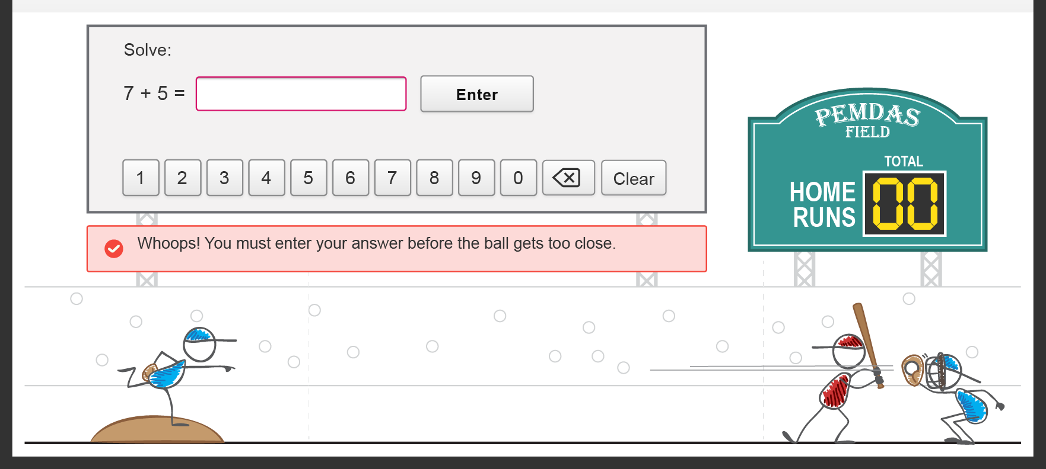
Home run derby
No answer
If the student does not enter an answer in time, They miss the ball through inaction and are provided feedback. Then they can move on to the next problem/pitch.

