Slide 1
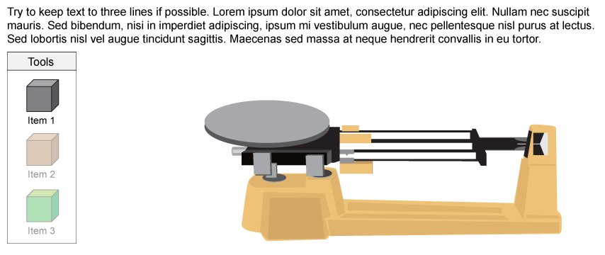
Measure - scale
01a
Notes:
Timing ≈ 3.5 minutes
Entry Audio: In this third step, you will determine the speed of the car on the lower racetrack. Make sure to follow the on-screen directions. Start by dragging the stopwatches to the four checkpoints.
Exit Audio: Once you have recorded the times for all four checkpoints, click ‘Next’ to calculate the average time it takes the car to reach each checkpoint.
Sources:
Brief Edgenuity descriptive title. “Title given by photographer/website,” artist’s name. Date uploaded [or N.d. if no date given] as License, Digital Image. URL (accessed with full date).

Slide 2
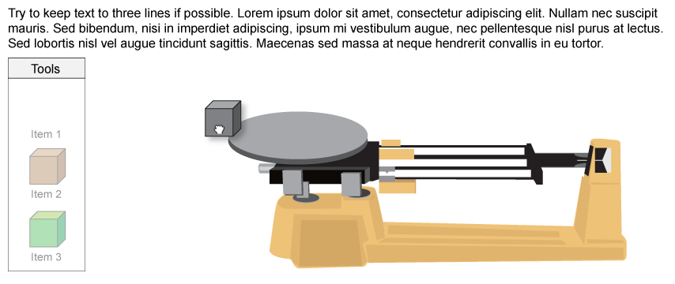
Measure - scale
01b
Student drags item to scale
Notes:
Timing ≈ 3.5 minutes
Entry Audio: In this third step, you will determine the speed of the car on the lower racetrack. Make sure to follow the on-screen directions. Start by dragging the stopwatches to the four checkpoints.
Exit Audio: Once you have recorded the times for all four checkpoints, click ‘Next’ to calculate the average time it takes the car to reach each checkpoint.
Sources:
Brief Edgenuity descriptive title. “Title given by photographer/website,” artist’s name. Date uploaded [or N.d. if no date given] as License, Digital Image. URL (accessed with full date).

Slide 3
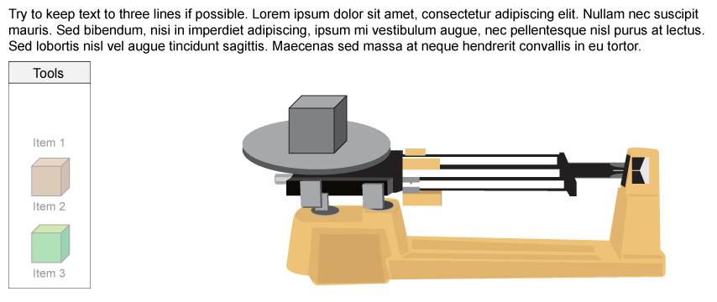
Measure - scale
01c
Item is placed on scale. scale doesn’t need to react at this point
Notes:
Timing ≈ 3.5 minutes
Entry Audio: In this third step, you will determine the speed of the car on the lower racetrack. Make sure to follow the on-screen directions. Start by dragging the stopwatches to the four checkpoints.
Exit Audio: Once you have recorded the times for all four checkpoints, click ‘Next’ to calculate the average time it takes the car to reach each checkpoint.
Sources:
Brief Edgenuity descriptive title. “Title given by photographer/website,” artist’s name. Date uploaded [or N.d. if no date given] as License, Digital Image. URL (accessed with full date).

Slide 4
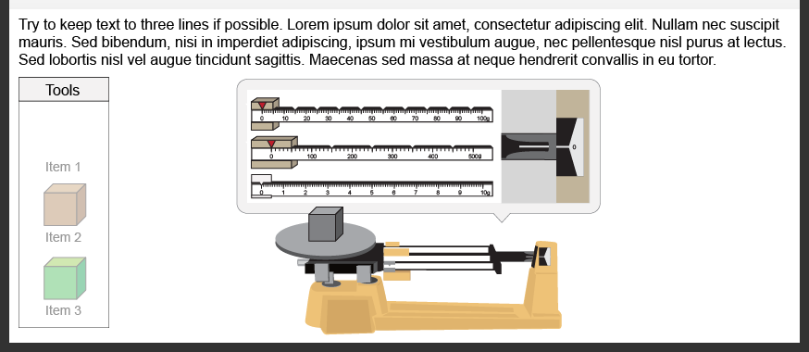
Measure - scale
01d
Display zoomed in view of bars and pointer
Notes:
Timing ≈ 3.5 minutes
Entry Audio: In this third step, you will determine the speed of the car on the lower racetrack. Make sure to follow the on-screen directions. Start by dragging the stopwatches to the four checkpoints.
Exit Audio: Once you have recorded the times for all four checkpoints, click ‘Next’ to calculate the average time it takes the car to reach each checkpoint.
Sources:
Brief Edgenuity descriptive title. “Title given by photographer/website,” artist’s name. Date uploaded [or N.d. if no date given] as License, Digital Image. URL (accessed with full date).

Slide 5
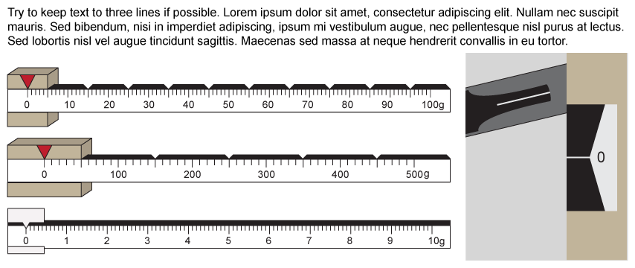
Measure - scale
02a
Scale is set to default 0g and pointer is above ‘0’ line
Notes:
Timing ≈ 3.5 minutes
Entry Audio: In this third step, you will determine the speed of the car on the lower racetrack. Make sure to follow the on-screen directions. Start by dragging the stopwatches to the four checkpoints.
Exit Audio: Once you have recorded the times for all four checkpoints, click ‘Next’ to calculate the average time it takes the car to reach each checkpoint.
Sources:
Brief Edgenuity descriptive title. “Title given by photographer/website,” artist’s name. Date uploaded [or N.d. if no date given] as License, Digital Image. URL (accessed with full date).

Slide 6
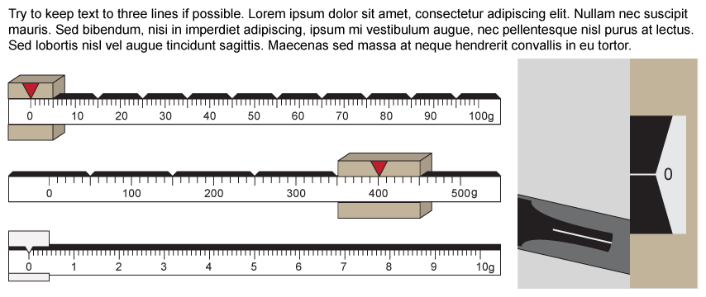
Measure - scale
02b
Student can slide weights along bars. When a weight is released, pointer will react. In this case, too much weight causes the pointer to descend below ‘0’ line
Notes:
Timing ≈ 3.5 minutes
Entry Audio: In this third step, you will determine the speed of the car on the lower racetrack. Make sure to follow the on-screen directions. Start by dragging the stopwatches to the four checkpoints.
Exit Audio: Once you have recorded the times for all four checkpoints, click ‘Next’ to calculate the average time it takes the car to reach each checkpoint.
Sources:
Brief Edgenuity descriptive title. “Title given by photographer/website,” artist’s name. Date uploaded [or N.d. if no date given] as License, Digital Image. URL (accessed with full date).

Slide 7
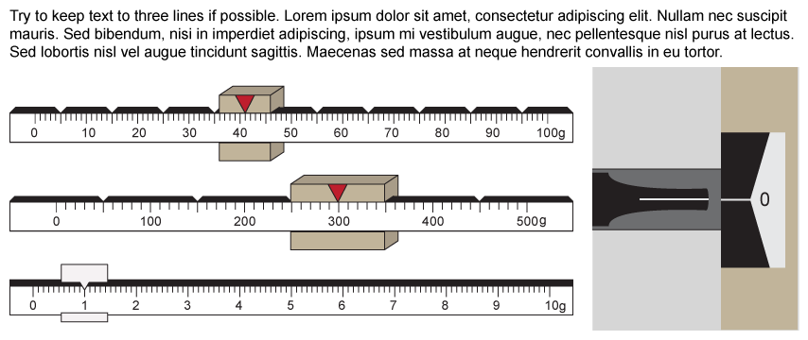
Measure - scale
02c
A perfect balance may look like this. Repeat actions from slides 1-6 for each item.
Notes:
Timing ≈ 3.5 minutes
Entry Audio: In this third step, you will determine the speed of the car on the lower racetrack. Make sure to follow the on-screen directions. Start by dragging the stopwatches to the four checkpoints.
Exit Audio: Once you have recorded the times for all four checkpoints, click ‘Next’ to calculate the average time it takes the car to reach each checkpoint.
Sources:
Brief Edgenuity descriptive title. “Title given by photographer/website,” artist’s name. Date uploaded [or N.d. if no date given] as License, Digital Image. URL (accessed with full date).

